Slide 1
16
Sorting:
A Deeper Look

Slide 2
With sobs and tears he sorted out
Those of the largest size …
  Lewis Carroll
‘Tis in my memory lock’d,
And you yourself shall keep the key of it.
  William Shakespeare
It is an immutable law in business that words are words, explanations are explanations, promises are promises — but only performance is reality.
  Harold S. Green

Slide 3
OBJECTIVES
In this chapter you will learn:
To sort an array using the selection sort algorithm.
To sort an array using the insertion sort algorithm.
To sort an array using the recursive merge sort algorithm.
To determine the efficiency of searching and sorting algorithms and express it in “Big O” notation.
To explore (in the chapter exercises) additional recursive sorts, including quicksort and a recursive version of selection sort.
To explore (in the chapter exercises) the bucket sort, which achieves very high performance, but by using considerably more memory than the other sorts we have studied—an example of the so-called “space–time trade-off.”

Slide 4
16.1 Introduction
16.2 Big O Notation
16.3 Selection Sort
16.4 Insertion Sort
16.5 Merge Sort

Slide 5
16.1 Introduction
Sorting data
  Place data in order
    Typically ascending or descending
    Based on one or more sort keys
  Algorithms
    Insertion sort
    Selection sort
    Merge sort
      More efficient, but more complex

Slide 6
16.1 Introduction (Cont.)
Big O notation
  Estimates worst-case runtime for an algorithm
    How hard an algorithm must work to solve a problem

Slide 7
16.2 Big O Notation
Big O notation
  Measures runtime growth of an algorithm relative to number of items processed
    Highlights dominant terms
    Ignores terms that become unimportant as n grows
    Ignores constant factors

Slide 8
16.2 Big O Notation (Cont.)
  Constant runtime
    Number of operations performed by algorithm is constant
      Does not grow as number of items increases
    Represented in Big O notation as O(1)
      Pronounced “on the order of 1” or “order 1”
    Example
      Test if the first element of an n-array is equal to the second element
        Always takes one comparison, no matter how large the array

Slide 9
16.2 Big O Notation (Cont.)
  Linear runtime
    Number of operations performed by algorithm grows linearly with number of items
    Represented in Big O notation as O(n)
      Pronounced “on the order of n” or “order n”
    Example
      Test if the first element of an n-array is equal to any other element
        Takes n - 1 comparisons
        n term dominates, -1 is ignored

Slide 10
16.2 Big O Notation (Cont.)
  Quadratic runtime
    Number of operations performed by algorithm grows as the square of the number of items
    Represented in Big O notation as O(n²)
      Pronounced “on the order of n²” or “order n²”
    Example
      Test if any element of an n-array is equal to any other element
        Takes n²/2 – n/2 comparisons
        n² term dominates, constant 1/2 is ignored, -n/2 is ignored

Slide 11
16.3 Selection Sort
Selection sort
  At ith iteration
    Swaps the ith smallest element with element i
  After ith iteration
    Smallest i elements are sorted in increasing order in first i positions
  Requires a total of (n² – n)/2 comparisons
    Iterates n - 1 times
      In ith iteration, locating ith smallest element requires n – i comparisons
    Has Big O of O(n²)

Slide 12
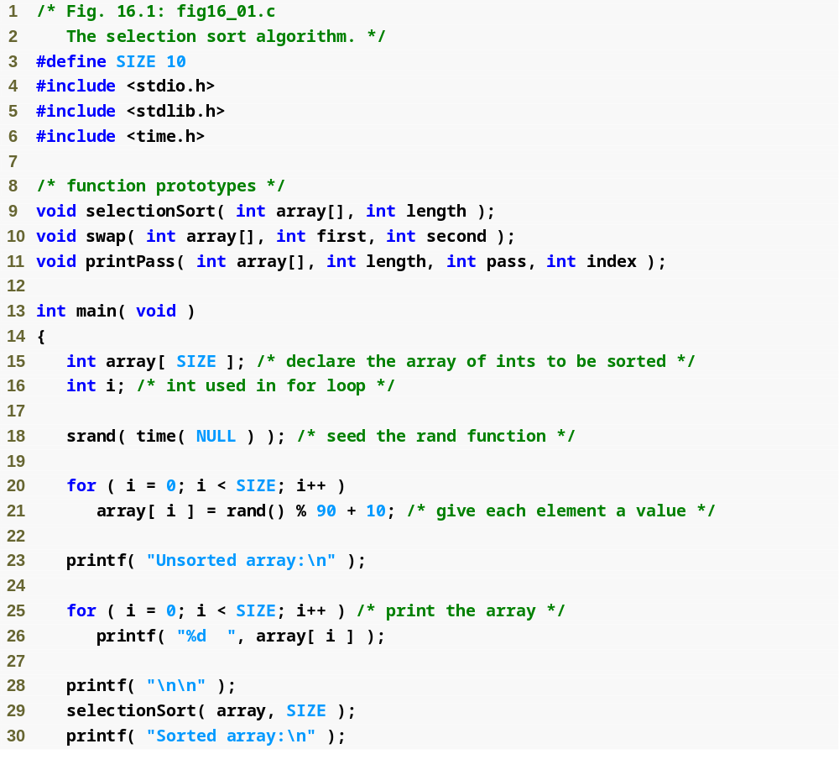
Outline
fig16_01.c
(1 of 4 )

Slide 13
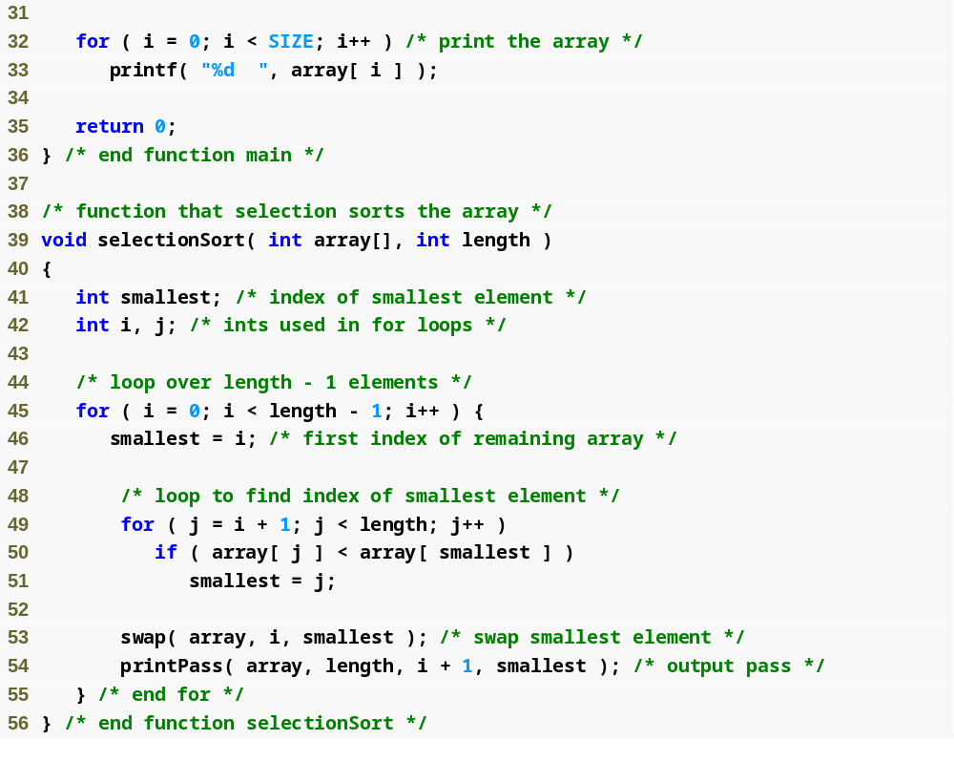
Outline
fig16_01.c
(2 of 4 )
Store the index of the smallest element in the remaining array
Iterate through the whole array length – 1 times
Initializes the index of the smallest element to the current item
Determine the index of the remaining smallest element
Place the smallest remaining element in the next spot

Slide 14
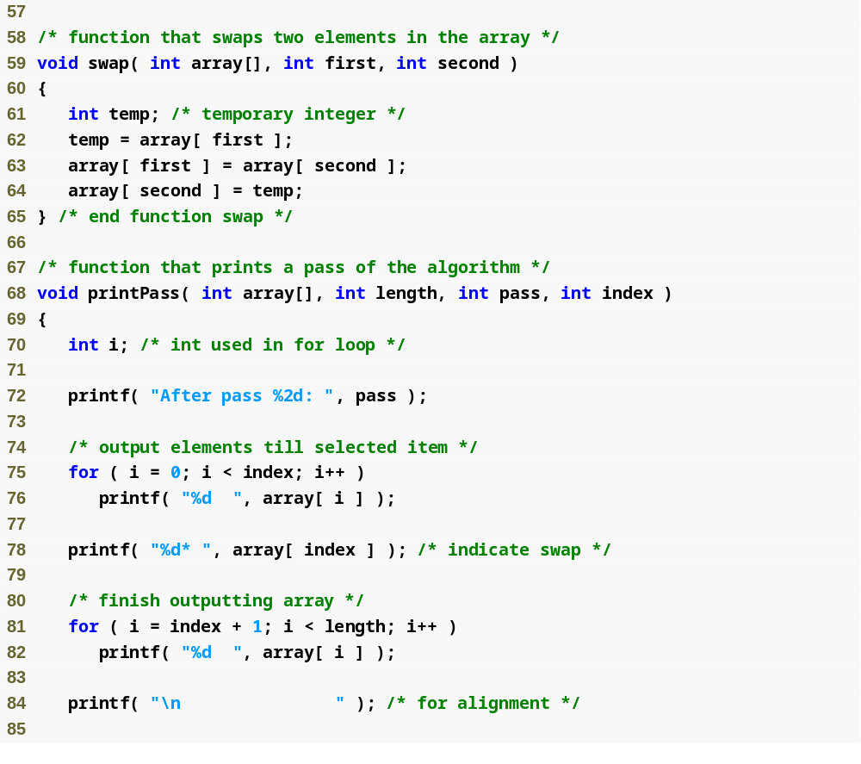
Outline
Swap two elements
fig16_01.c
(3 of 4 )

Slide 15
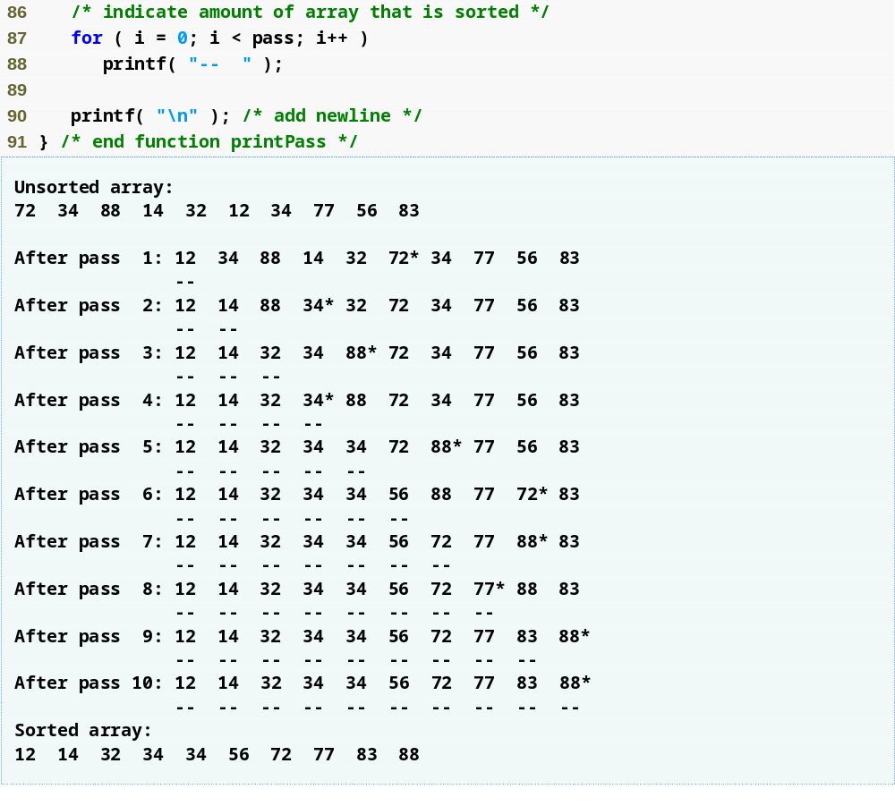
Outline
fig16_01.c
(4 of 4 )

Slide 16
16.4 Insertion Sort
Insertion sort
  At ith iteration
    Insert (i + 1)th element into correct position with respect to first i elements
  After ith iteration
    First i elements are sorted
  Requires a worst-case of n² inner-loop iterations
    Outer loop iterates n - 1 times
      Inner loop requires n – 1iterations in worst case
    For determining Big O, nested statements mean multiply the number of iterations
    Has Big O of O(n²)

Slide 17
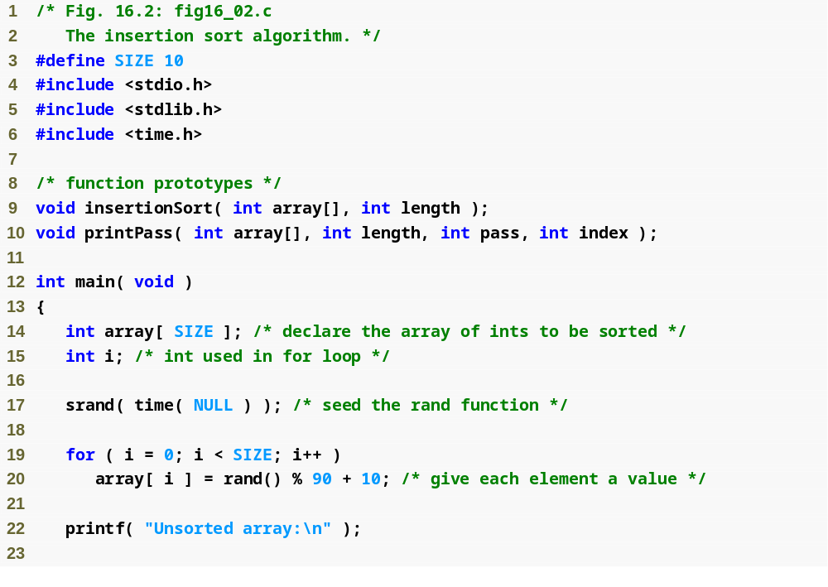
Outline
fig16_02.c
(1 of 4 )

Slide 18
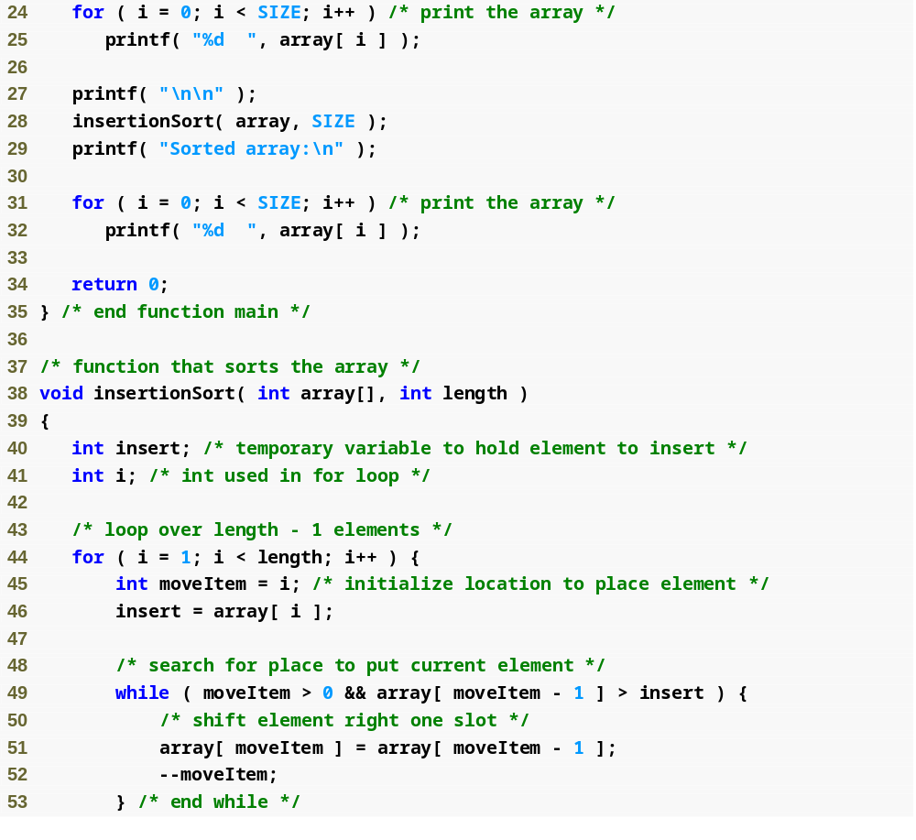
Outline
fig16_02.c
(2 of 4 )
Holds the element to be inserted while the order elements are moved
Iterate through length - 1 items in the array
Keep track of where to insert the element
Stores the value of the element that will be inserted in the sorted portion of the array
Loop to locate the correct position to insert the element
Moves an element to the right and decrement the position at which to insert the next element

Slide 19
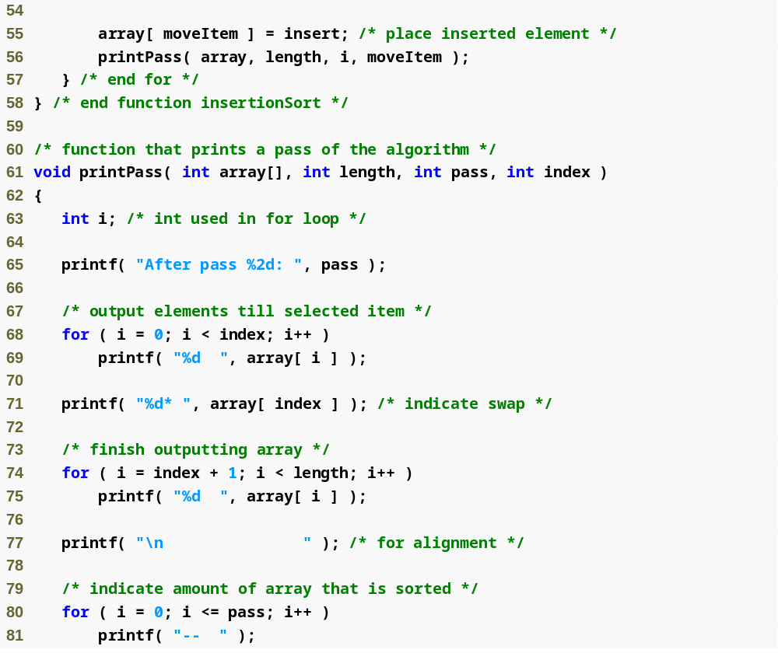
Outline
Inserts the element in place
fig16_02.c
(3 of 4 )

Slide 20
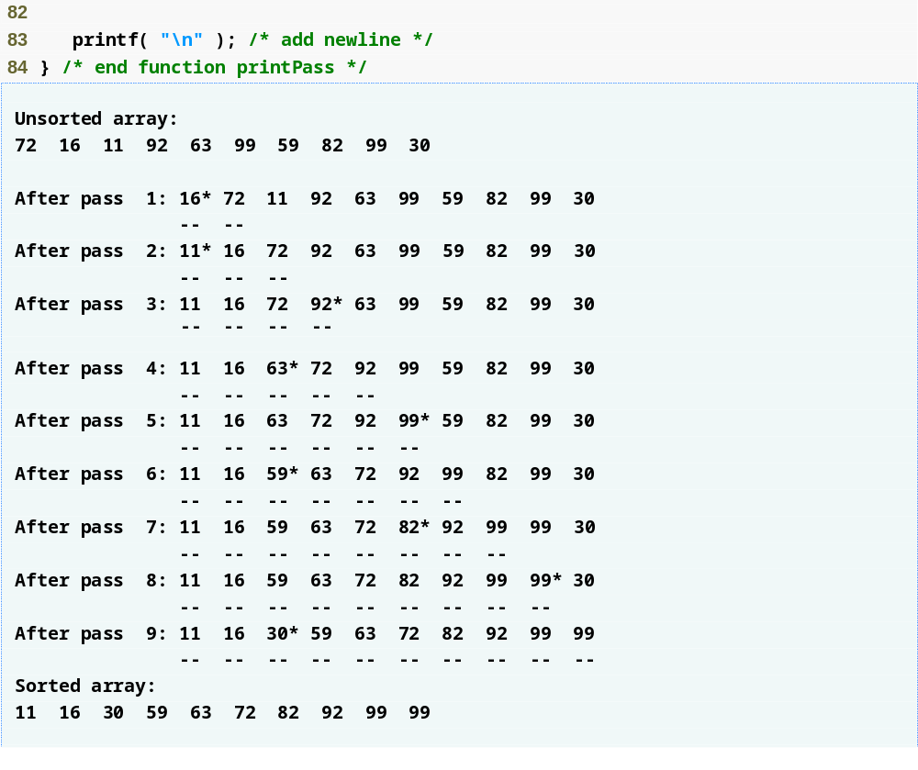
Outline
fig16_02.c
(4 of 4 )

Slide 21
16.5 Merge Sort
Merge sort
  Sorts array by
    Splitting it into two equal-size subarrays
      If array size is odd, one subarray will be one element larger than the other
    Sorting each subarray
    Merging them into one larger, sorted array
      Repeatedly compare smallest elements in the two subarrays
      The smaller element is removed and placed into the larger, combined array

Slide 22
16.5 Merge Sort (Cont.)
  Our recursive implementation
    Base case
      An array with one element is already sorted
    Recursion step
      Split the array (of ≥ 2 elements) into two equal halves
        If array size is odd, one subarray will be one element larger than the other
      Recursively sort each subarray
      Merge them into one larger, sorted array

Slide 23
16.5 Merge Sort (Cont.)
Merge sort (Cont.)
  Sample merging step
    Smaller, sorted arrays
      A: 4 10 34 56 77
      B: 5 30 51 52 93
    Compare smallest element in A to smallest element in B
      4 (A) is less than 5 (B)
        4 becomes first element in merged array
      5 (B) is less than 10 (A)
        5 becomes second element in merged array
      10 (A) is less than 30 (B)
        10 becomes third element in merged array
      Etc.

Slide 24
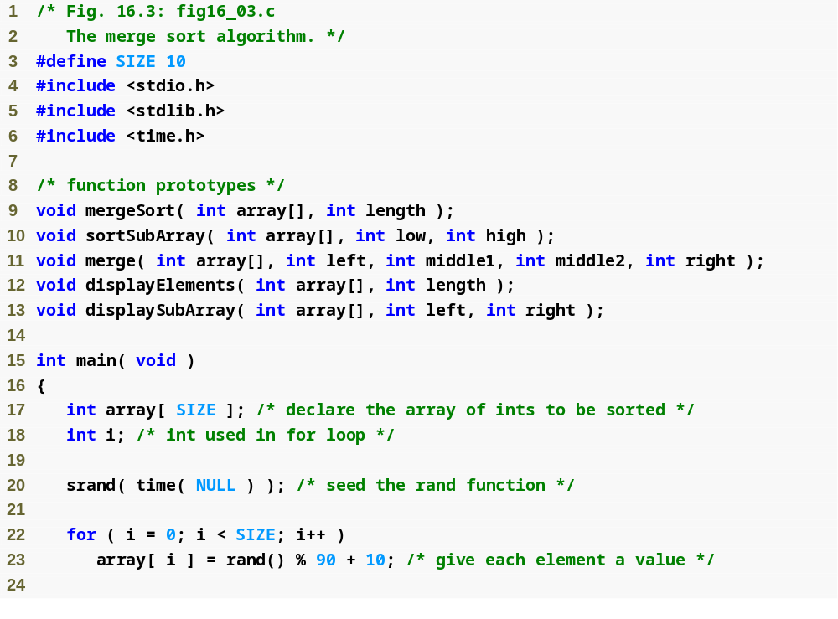
Outline
fig16_03.c
(1 of 8 )

Slide 25
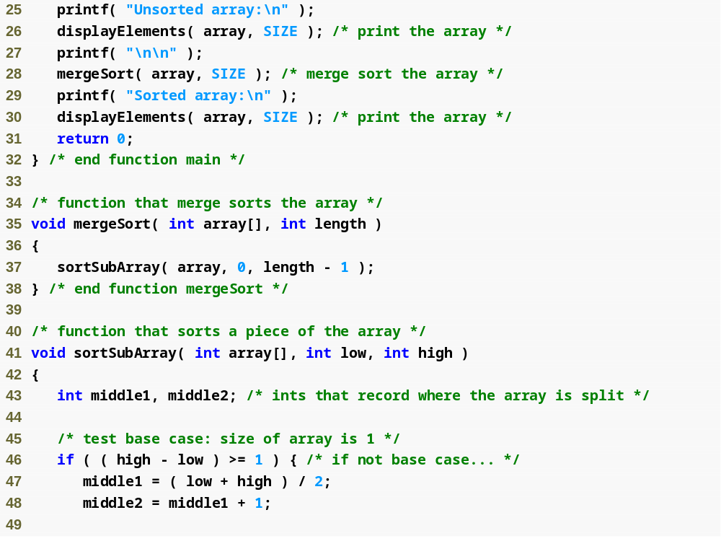
Outline
fig16_03.c
(2 of 8 )
Call function sortSubArray with 0 and length – 1 as the beginning and ending indices
Test the base case
Split the array in two

Slide 26
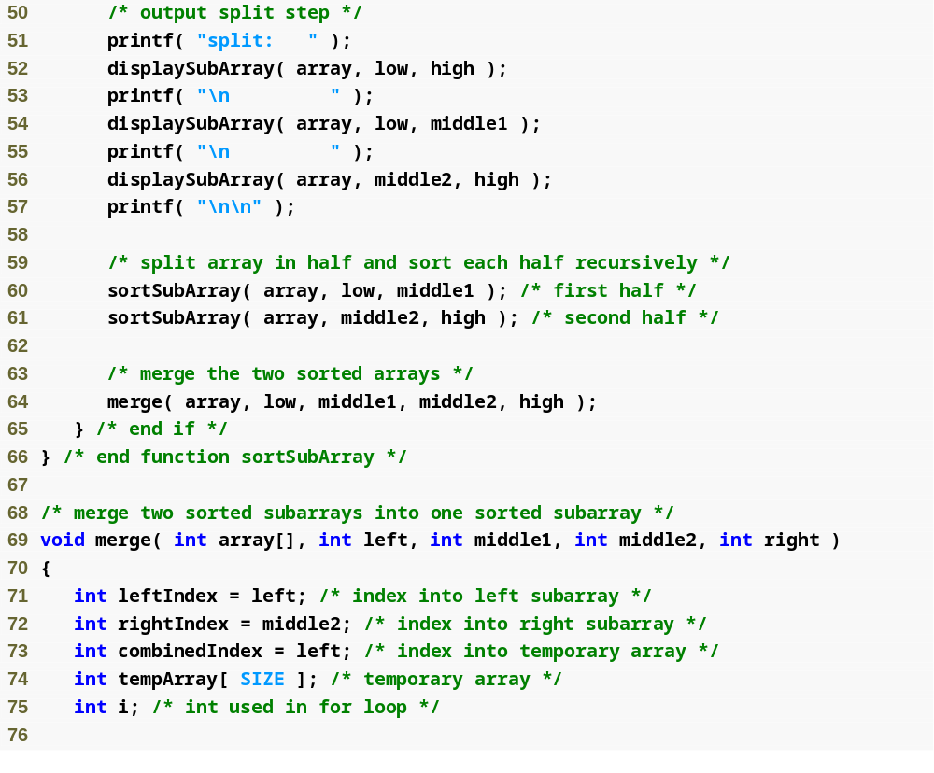
Outline
fig16_03.c
(3 of 8 )
Recursively call function sortSubArray on the two subarrays
Combine the two sorted arrays into one larger, sorted array

Slide 27
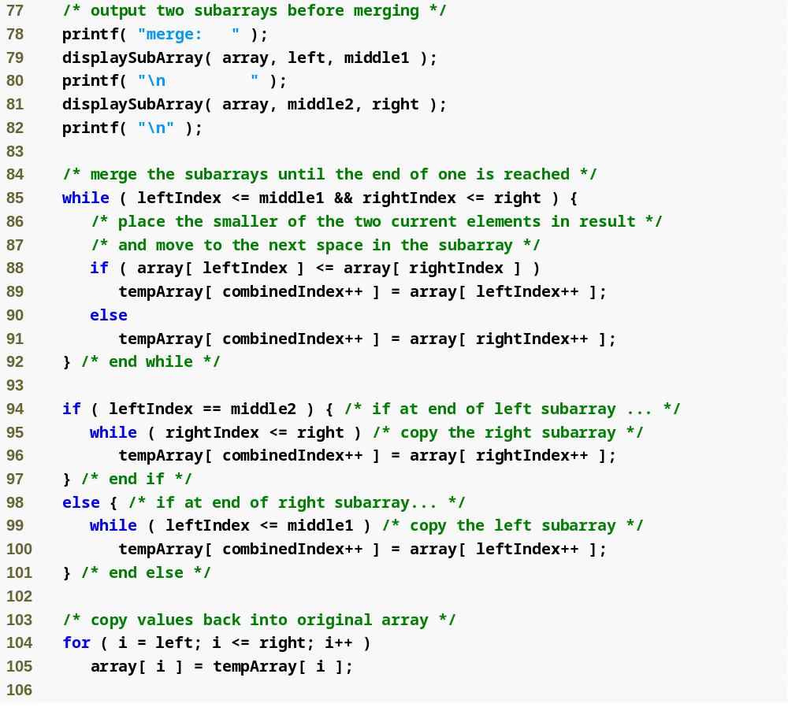
Outline
Loop until the end of either subarray is reached
fig16_03.c
(4 of 8 )
Test which element at the beginning of the arrays is smaller
Place the smaller element in the combined array
Fill the combined array with the remaining elements of the right array or…
…else fill the combined array with the remaining elements of the left array
Copy the combined array into the original array

Slide 28
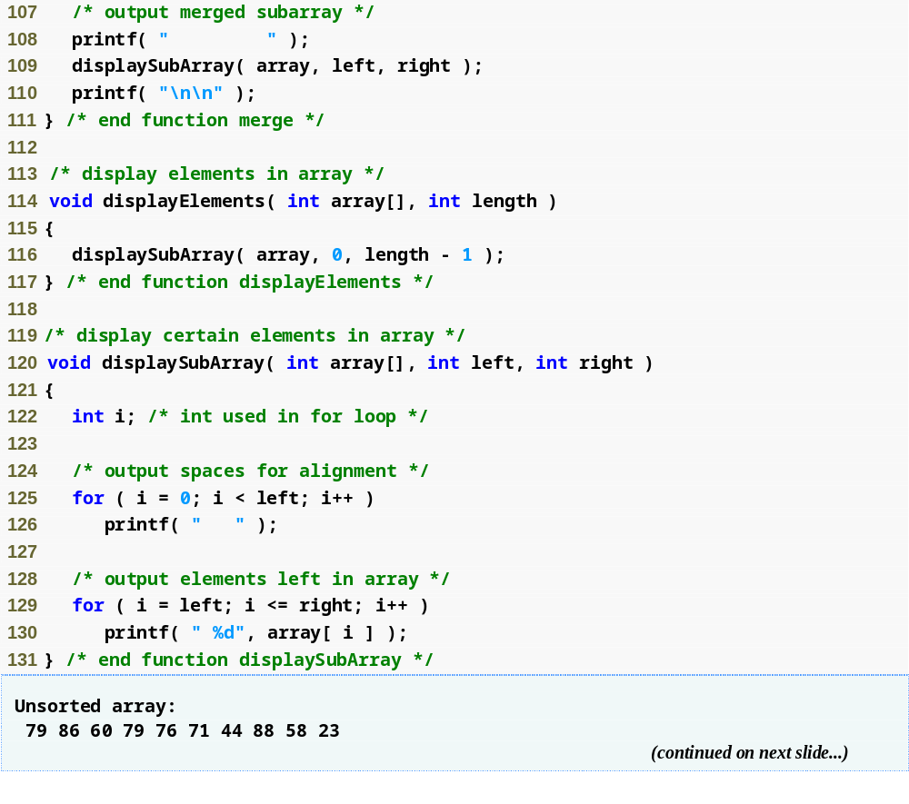
Outline
fig16_03.c
(5 of 8 )

Slide 29
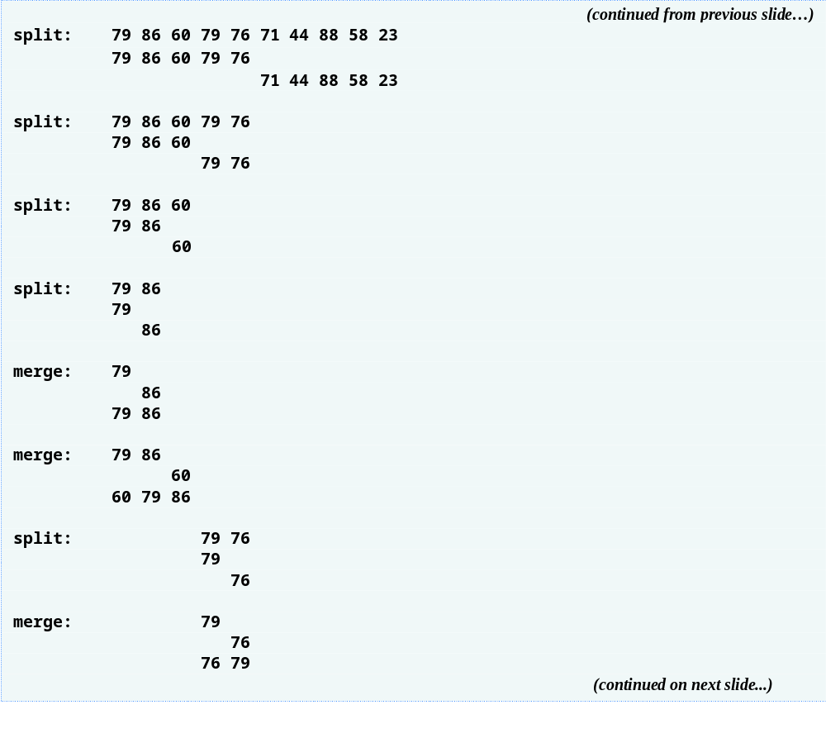
Outline
fig16_03.c
(6 of 8 )

Slide 30
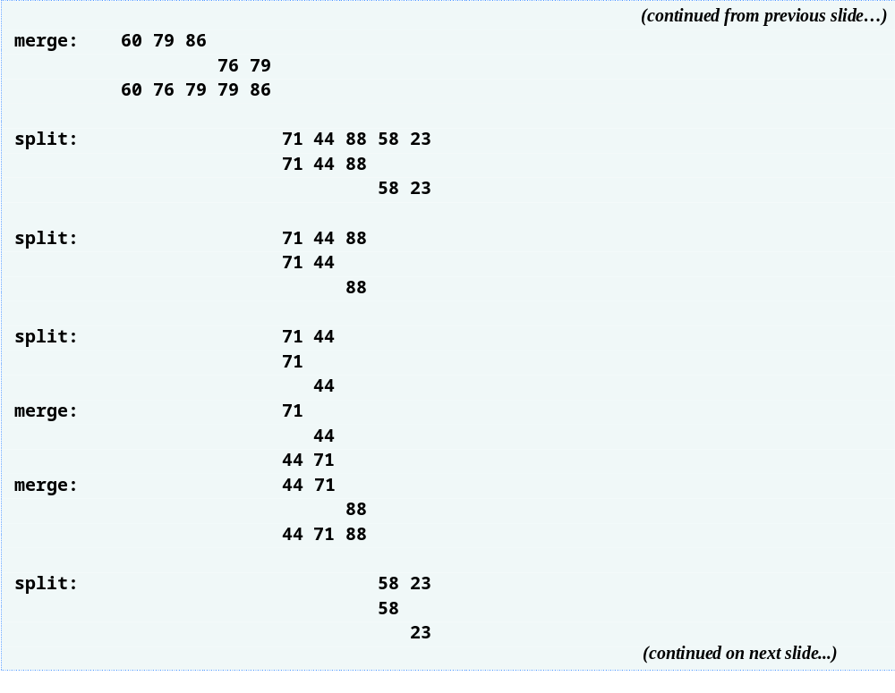
Outline
fig16_03.c
(7 of 8 )

Slide 31
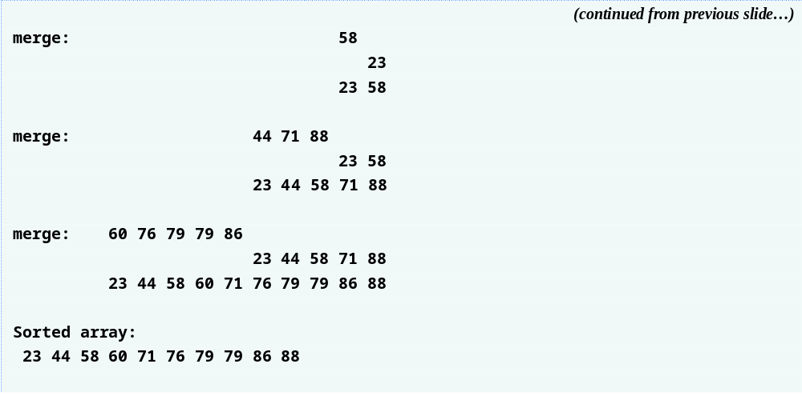
Outline
fig16_03.c
(8 of 8 )

Slide 32
16.5 Merge Sort (Cont.)
Efficiency of merge sort
  n log n runtime
    arrays means log ₂ n levels to reach base case
      Doubling size of array requires one more level
      Quadrupling size of array requires two more levels
    O(n) comparisons are required at each level
      Calling sortSubArray with a size-n array results in
        Two sortSubArray calls with size-n/2 subarrays
        A merge operation with n – 1 (order n) comparisons
      So, always order n total comparisons at each level
    Represented in Big O notation as O(n log n)
      Pronounced “on the order of n log n” or “order n log n”

Slide 33
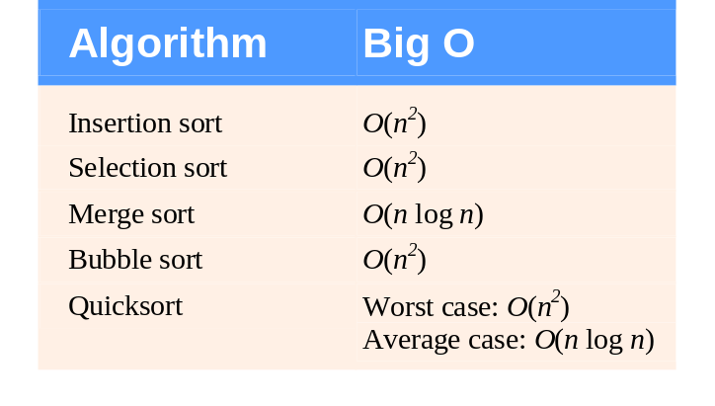
Fig. 16.4 | Searching and sorting algorithms with Big O values.

Slide 34
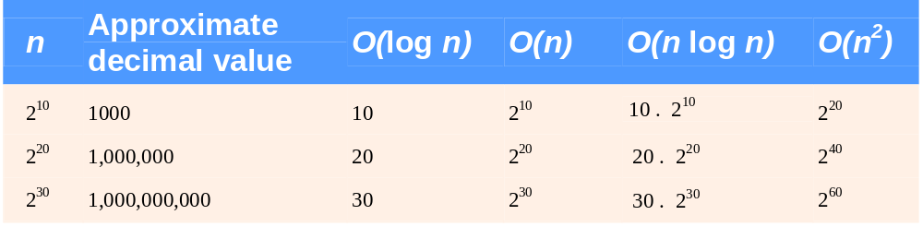
Fig. 16.5 | Approximate number of comparisons for common Big O notations.

